Slide 1

NCR 10596
QER: Inventory for DRAPS Products SF031900C002.A1 - Zeta wires unlocking

Slide 2
Pipe section / details
Item | Traceability / identification
Project number | SF031900C002
Project name | DRAPS Products
Pipe section | SF031900C002.A1
ST number | ST076.60615
Affected layer / equipment | Zeta spiralling
Length affected | 1522.5m
Drawing number / MP code / STA / Dimension | ZETA 8 FI 52(MP744)

Slide 3
Overview of anomaly
Problem Description:-
During zeta vault spiralling for DRAPS Products SF031900C002.A1 (ST076.60615), zeta wire unlocked was detected at length 1522.5m on the pipe.
Root Cause:-
The root cause is currently under investigation.
Problem Handling:-
Reparation by un-spiral has been performed to re-position the wires to be in a good spiral. Thus, this reparation was accepted as it is and the dimensional after the repair is within the criteria.

Slide 4
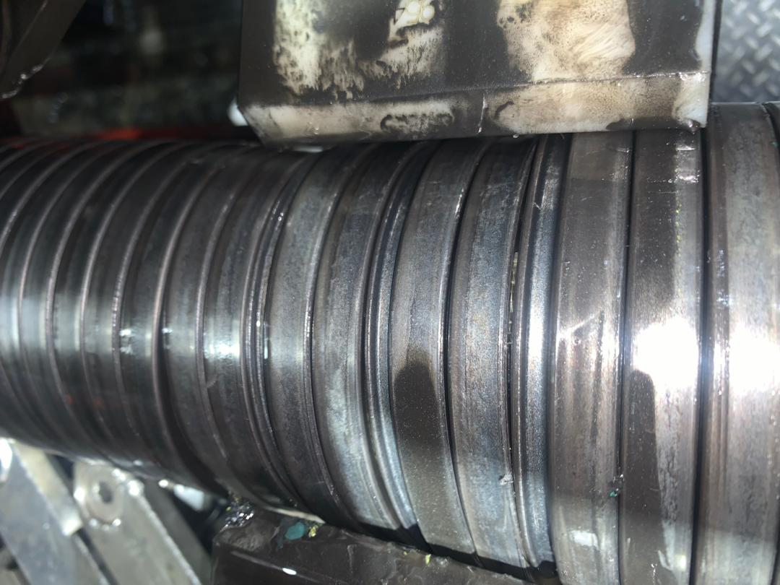
Zeta wire unlock
Figure 1 : Zeta wire unlocked was detected at length 1522.5m on the pipe.

Slide 5
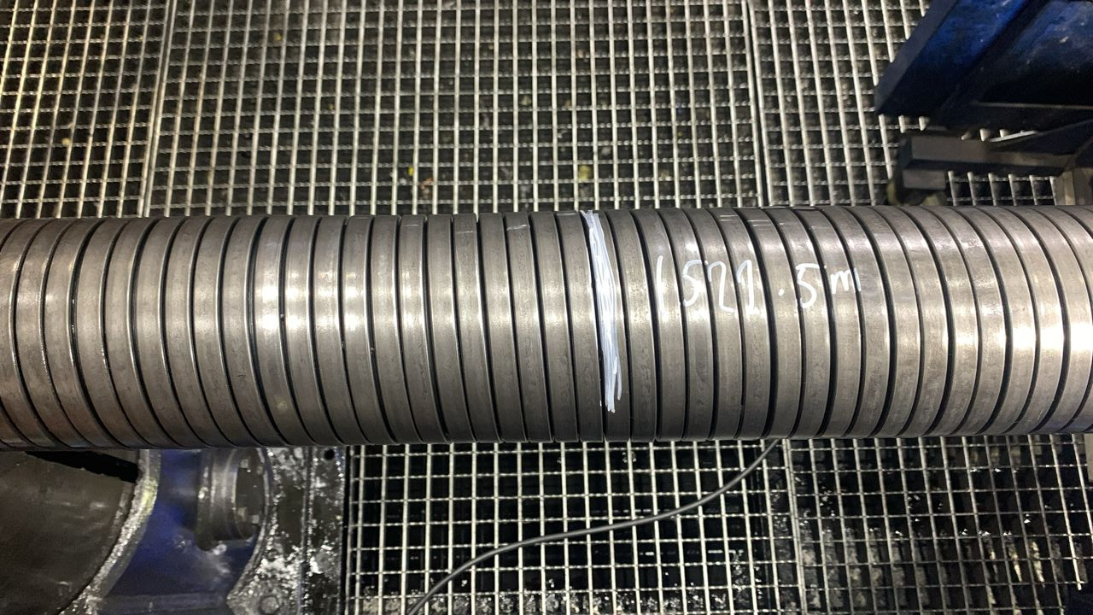
After repaired
Figure 2 : Reparation by un-spiral has been performed to re-position the wires to be in a good spiral.

Slide 6

THANK YOU

